Slide 1
AngularJS
Intern Training
Antony Zhang
2017.07.10

Slide 2
Agenda
1
Angular Expressions
2
Angular Modules
3
Angular Directives
4
Angular Model
5
Angular Data Binding
6
Angular Controllers
7
Angular Scopes
8
Angular Filters
9
Angular Services
10
Angular Http

Slide 3
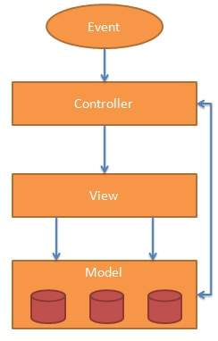
0
AngularJS General Features
AngularJS is a efficient framework that can create Rich Internet Applications (RIA).
AngularJS provides developers an options to write client side applications using JavaScript in a clean Model View Controller (MVC) way.
Applications written in AngularJS are cross-browser compliant. AngularJS automatically handles JavaScript code suitable for each browser.
AngularJS is open source, completely free, and used by thousands of developers around the world. It is licensed under the Apache license version 2.0.

Slide 4
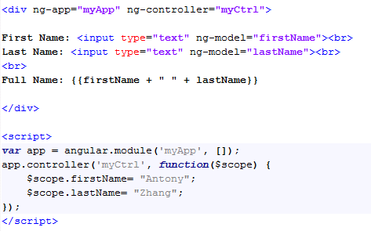
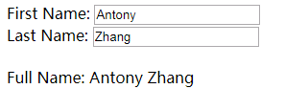
0
AngularJS Example

Slide 5
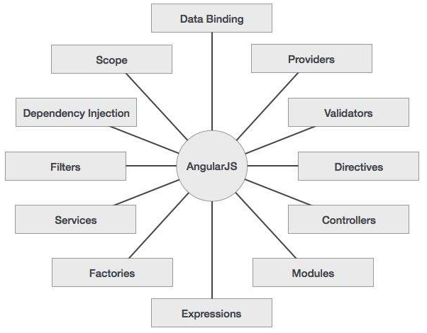
0
Concepts in AngularJS
Notes:
Data-binding − It is the automatic synchronization of data between model and view components.
Scope − These are objects that refer to the model. They act as a glue between controller and view.
Controller − These are JavaScript functions that are bound to a particular scope.
Services − AngularJS come with several built-in services for example $http to make a XMLHttpRequests. These are singleton objects which are instantiated only once in app.
Filters − These select a subset of items from an array and returns a new array.
Directives − Directives are markers on DOM elements (such as elements, attributes, css, and more). These can be used to create custom HTML tags that serve as new, custom widgets. AngularJS has built-in directives (ngBind, ngModel...)
Templates − These are the rendered view with information from the controller and model. These can be a single file (like index.html) or multiple views in one page using "partials".
Routing − It is concept of switching views.
Model View Whatever − MVC is a design pattern for dividing an application into different parts (called Model, View and Controller), each with distinct responsibilities. AngularJS does not implement MVC in the traditional sense, but rather something closer to MVVM (Model-View-ViewModel). The Angular JS team refers it humorously as Model View Whatever.
Deep Linking − Deep linking allows you to encode the state of application in the URL so that it can be bookmarked. The application can then be restored from the URL to the same state.
Dependency Injection − AngularJS has a built-in dependency injection subsystem that helps the developer by making the application easier to develop, understand, and test.

Slide 6
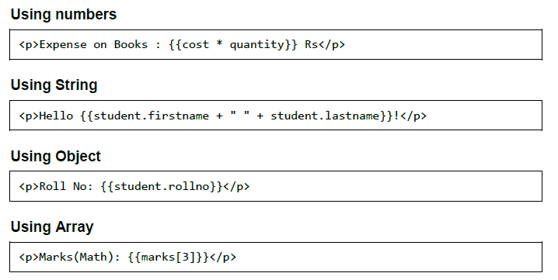
1
Angular Expressions
Expressions are used to bind application data to HTML. Expressions are written inside double curly braces such as in {{ expression}}. Expressions behave similar to ngbind directives. AngularJS expressions are pure JavaScript expressions and output the data where they are used.

Slide 7
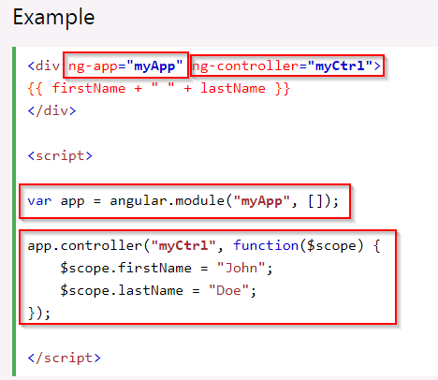
2
Angular Modules
An AngularJS module defines an application.
The module is a container for the different parts of an application.
The module is a container for the application controllers.
Controllers always belong to a module.

Slide 8
3
Angular Directives
AngularJS directives are used to extend HTML. They are special attributes starting with ng-prefix. Let us discuss the following directives:
ng-app
ng-controller
ng-model / ng-value
ng-init
ng-repeat
ng-bind
ng-bind-html
ng-if / ng-show / ng-hide
ng-class
ng-include
ng-view
https://www.w3schools.com/angular/angular_ref_directives.asp

Slide 9
3
Angular Customized Directive
In addition to all the built-in AngularJS directives, you can create your own directives. New directives are created by using the .directive function.
Restricts:
E for Element name
A for Attribute
C for Class
M for Comment
template / templateUrl:
scope:
link:

Slide 10
Exercise 1
<my-customized-table headers="['C1','C2','C3']" data="[['A1', 'A2'], [1, 2, 3], [-1, -2, -3]]"/>
C1 | C2 | C3
A1 | A2
1 | 2 | 3
-1 | -2 | -3

Slide 11
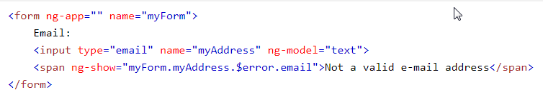
4
Angular Model
The ng-model directive binds the value of HTML controls (input, select, textarea) to application data.
Two-Way Binding
Validate User Input
Application Status
ng-empty
ng-not-empty
ng-touched
ng-untouched
ng-valid
ng-invalid
ng-dirty
ng-pending
ng-pristine

Slide 12


5
Angular Data Binding
You can use the ng-bind directive
You can also use double braces {{ }} to display content from the model

Slide 13
6
Angular Controllers
AngularJS controllers control the data of AngularJS applications
AngularJS controllers are regular JavaScript Objects.
A controller can also have methods (variables as functions)

Slide 14
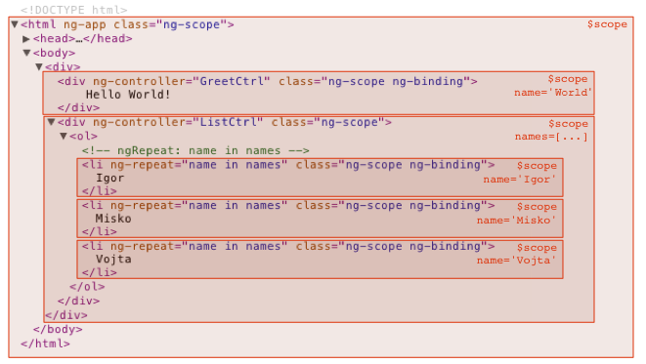
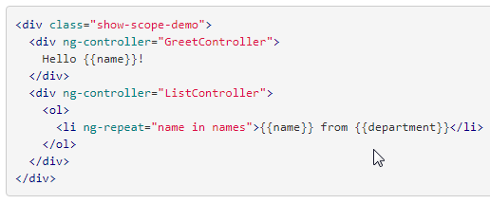
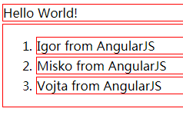
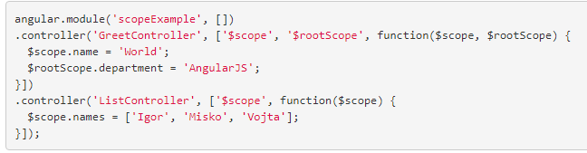
7
Angular Scopes
The scope is the binding part between the HTML (view) and the JavaScript (controller).
The scope is an object with the available properties and methods.
The scope is available for both the view and the controller.

Slide 15
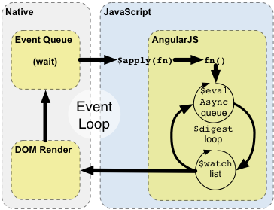
7
Angular Scopes
$scope.$watch
$scope.$on
$scope.$apply
$scope.$eval
$scope.$emit
$scope.$broadcast
https://docs.angularjs.org/guide/scope

Slide 16
8
Angular Filters
AngularJS provides filters to transform data:
currency : Format a number to a currency format.
date : Format a date to a specified format.
filter : Select a subset of items from an array.
json : Format an object to a JSON string.
limitTo : Limits an array/string, into a specified number of elements/characters.
lowercase : Format a string to lower case.
number : Format a number to a string.
orderBy : Orders an array by an expression.
uppercase : Format a string to upper case.
Filters can be added to expressions by using the pipe character |, followed by a filter.
Filters can be called in controllers by calling $filter.
Custom Filters

Slide 17
Exercise 2
Define a custom table template
User can filter each column by input
User can click the column header to sort table
Table is colorful.
If no result, should display “No result”
First Name↓ | Last Name | Gender | Departure
Antony | Zhang | M | CS
David | Li | M | OOCL
Lisa | Wang | F | HR
Michelle | Xiao | M | MKT
No Result

Slide 18
9
Angular Services
AngularJS supports the concept of Separation of Concerns using services architecture
Services are JavaScript functions
Services can be injected into other services and filters.
AngularJS has about 30 built-in services:
$http
$location
$filter
$interval
$timeout
$route
$window
$location
$translate
…

Slide 19
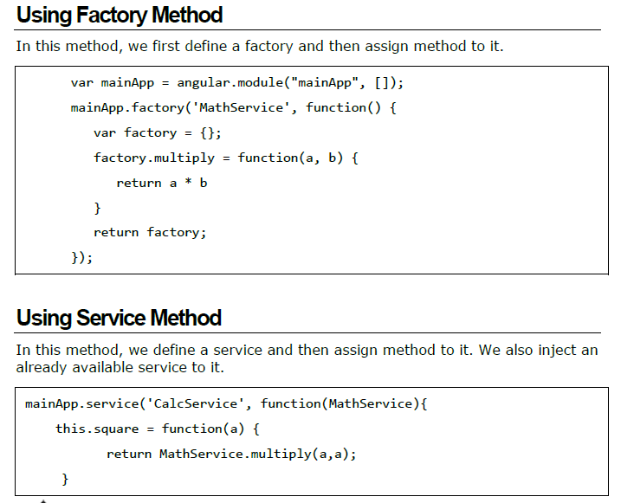
9
Angular Services
There are two ways to create a service:
Factory
Service

Slide 20
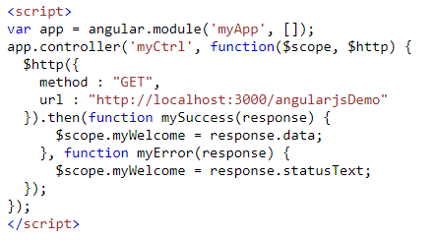
10
Angular Http
$http is an AngularJS service for reading data from remote servers.
Shortcut methods of $http:
.delete()
.get()
.head()
.jsonp()
.patch()
.post()
.put()
The response from the server is an object with these properties:
.config the object used to generate the request.
.data a string, or an object, carrying the response from the server.
.headers a function to use to get header information.
.status a number defining the HTTP status.
.status Text a string defining the HTTP status.

Slide 21
Others
ng-view: The ng-view directive simply creates a place holder where a corresponding view (HTML or ng-template view) can be placed based on the configuration.
How to define the angular routes by $routeProvider
AngularJS Events
Angular-bootstrap

Slide 22
References
https://docs.angularjs.org/guide/
https://www.w3schools.com/angular/
https://angular-ui.github.io/bootstrap/
https://www.npmjs.com/
https://www.bigschedules.com

Slide 23
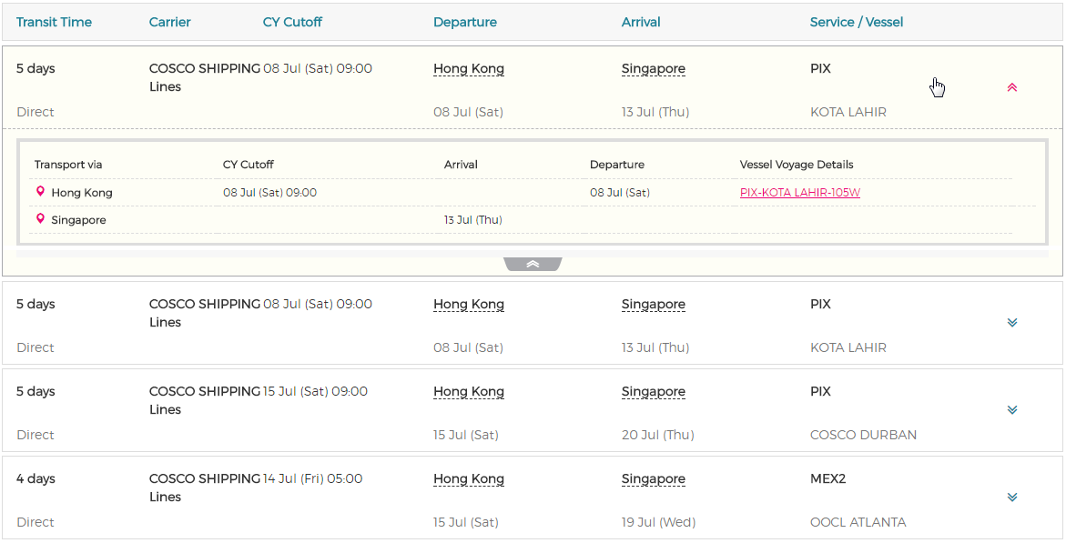
Exercise 3
Search

